Slide 1
STAR User Training
Hamilton Guru
Technical Trainer

Slide 2
Agenda
Day 1 | Introduction Editors Basic programming
Day 2 | Basic programming continued Pipetting and transportation Teaching positions
Day 3 | Tracing Sample tracking and worklists Advanced programming
Day 4 | Advanced programming continued Error handling Custom dialogs
Day 5 | Defining labware Defining liquid classes
Notes:
STAR Introduction
Software Installation & Configuration
Method Creation Overview
Deck Layout Editor
Method Editor
Sequence Editor & Sequence Design
Repeating Steps with Loop/End-Loop
User Input, User Output & Variables If-Else Method Branching
Pipetting Steps
Tip Counting Library
Run Control
Transport Steps
Teaching a Position
Trace Files
Importing/Exporting Methods
Arrays
Libraries,
File Handling
Sample Tracking
Import Worklist and Load and Match
Sub-Methods
Error Settings
Error Handling by User
HSL and Firmware Commands
Other Commands
Custom Dialog
Defining Labware with Labware Editor

Slide 3




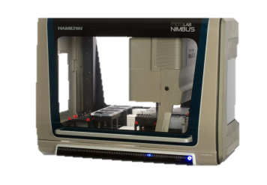
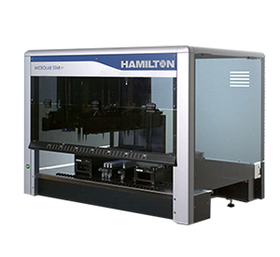
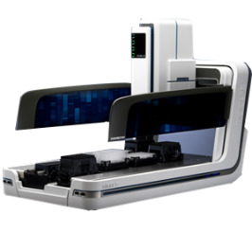
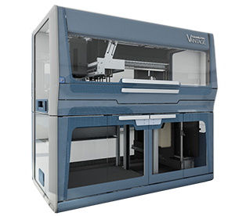
Software – Venus’s Vector Core
Compatible Liquid Handlers
VECTOR
NIMBUS 8 Vector + NIMBUS8 steps
Run
Control
Labware
Editor
Liquid Class
Editor
Method
Editor
Optional plugins
Scheduler
TADM
NIMBUS Channels Vector + NIMBUS4 steps + INSTINCT 4
NIMBUS 384 Vector + NIMBUS384 steps
+ INSTINCT 384
NIMBUS 96 Vector + NIMBUS96 steps
+ INSTINCT 96
VENUS Vector + STAR steps
VENUS on VANTAGE STAR<>VANTAGE translator

Slide 4
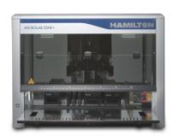
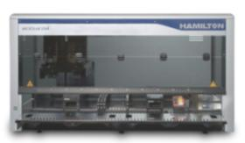
Microlab® STAR
STAR Models
Sequential
Transfer and Aliquotting
Robot
STAR^{let}
~1m wide
30 tracks
VST120.01
STAR
~1.5m wide
54 tracks
Pipettes small quantities of liquid from one container to another (aspirate, dispense)
All have (mostly) identical components and electronics
STAR^{plus}
~2m wide
71 tracks

Slide 5
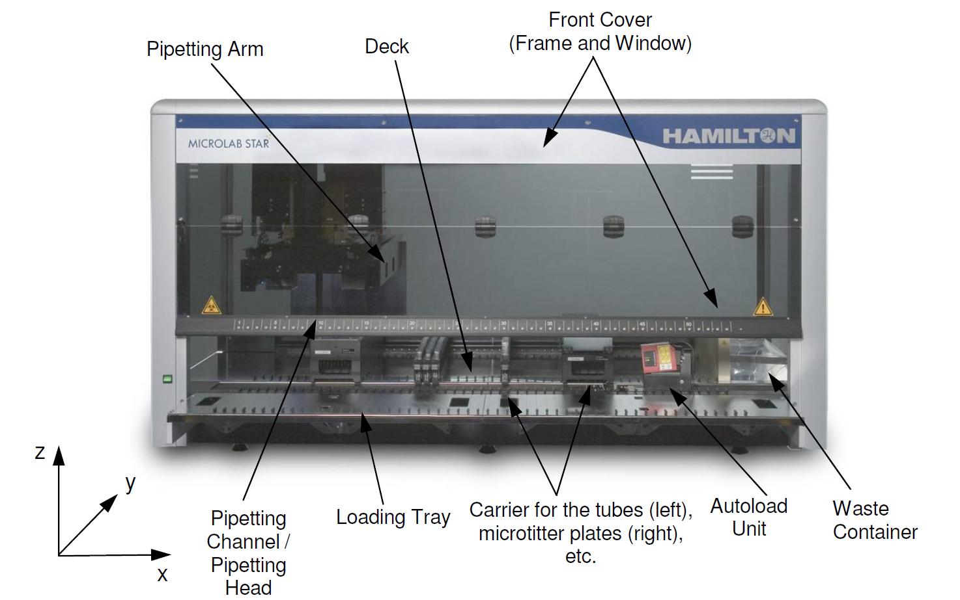
Microlab® STAR
Hardware Overview

Slide 6
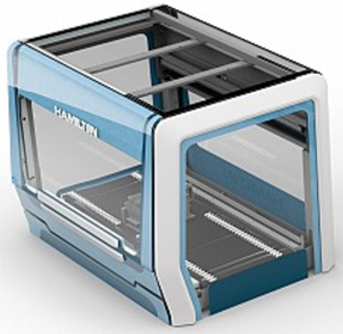
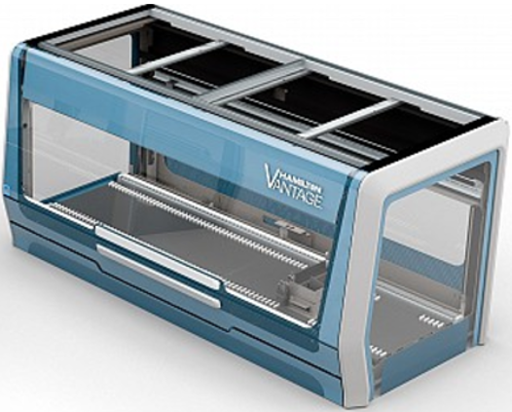


Compatible Liquid Handlers
VANTAGE
The VANTAGE line has two models, and is the latest model for integratable/programmable automated liquid handlers!
1.3m
54 tracks
2.0m
80 tracks
Compared to STAR line:
Linear Motors on X and Y
Rear Integration possible
IPG vs ISWAP
Logistic Cabinet Options
- Deck Pass Through slots
- Wastes
- Entry Exits

Slide 7
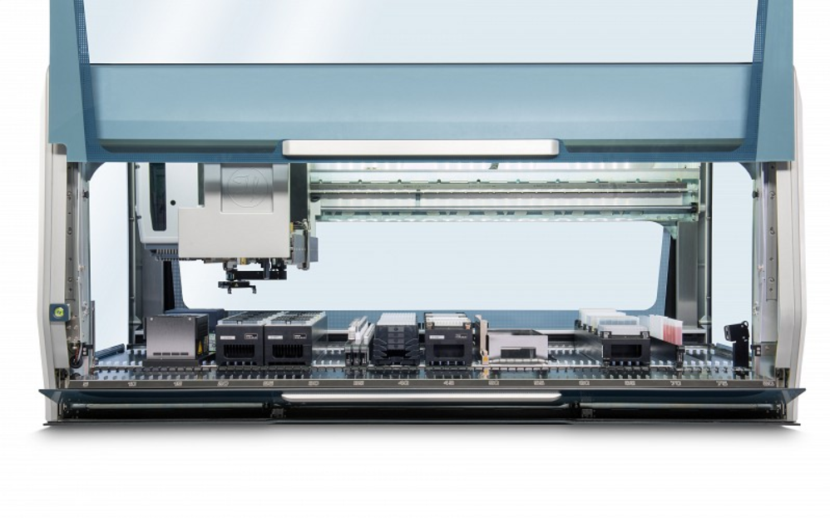
Instrument Overview
VANTAGE
Pipettor Door (open)
Pipetting Arm
Carriers
Integrated RGBW LED lighting
Power Button
Loading Tray (open)
IDL
Deck

Slide 8
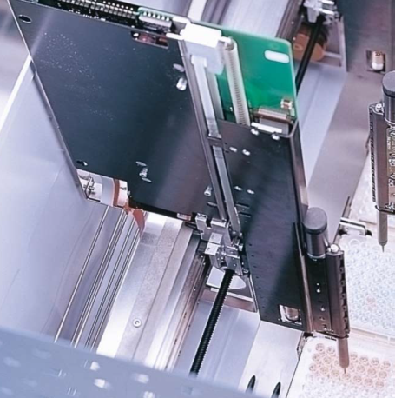
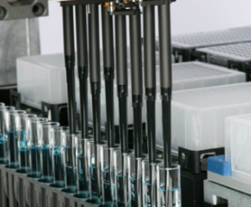
Microlab® STAR
Channels
2 Sizes - 1000μL or 5mL
Independent Movement in Y and Z
Numbered from back to front
Minimum distance (raster) between 1000 μL channels is 9mm – same as the distance between wells on a SBS Format 96-Well plate
1
8
Notes:
Method Development Demonstration: demonstrate from start to finish the process of developing and running a new method.
Talk out the process and explain the overview of what is going on.

Slide 9
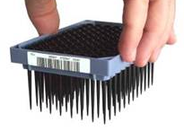
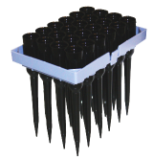
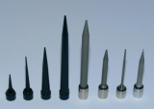
Microlab® STAR
Tips
Certified RNAse, DNAse and Pyrogen free
Disposable Tips for 1000µL Channel
Filtered and Non-Filtered Types
10μL Low Volume
50μL Mid-Volume
300μL Standard Volume
1000μL High Volume
Disposable Tips for 5mL Channel
5mL Filtered and Non-Filtered
Liquid capacity reduced to 4mL for filtered tips.
Reusable Steel Needles
Offered in various volumes with tip washing station for high throughput applications.
Notes:
Method Development Demonstration: demonstrate from start to finish the process of developing and running a new method.
Talk out the process and explain the overview of what is going on.

Slide 10
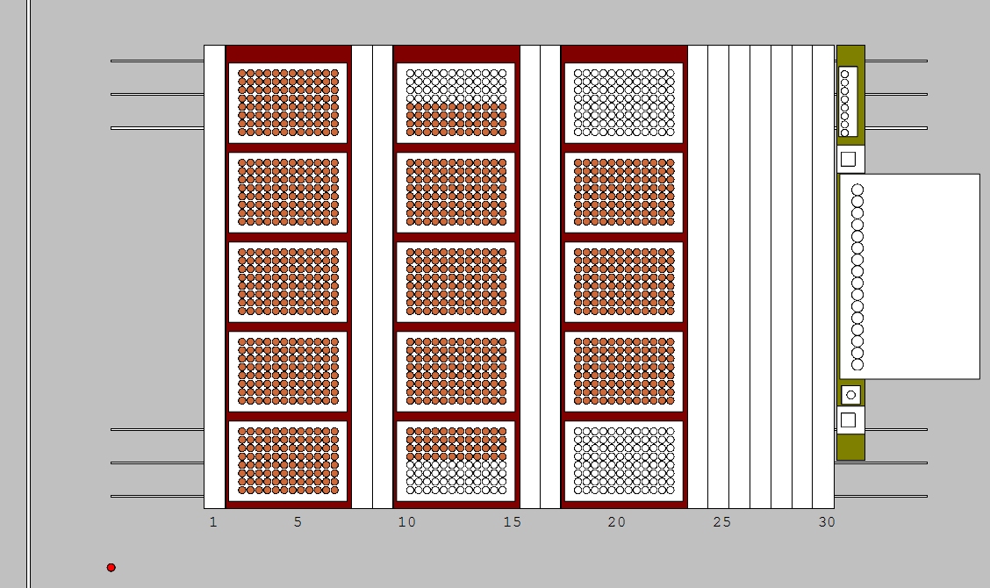
Microlab® STAR
Deck and Channel Access
On 4x and 8x 1000μL-channel instruments, all channels reach every position on the deck. As more channels are added, less of the deck is accessible by all channels.
4/8
12
16
The STAR uses a cartesian coordinate system that is located 100mm below the deck.
Instrument's origin (0,0,0)
Notes:
Method Development Demonstration: demonstrate from start to finish the process of developing and running a new method.
Talk out the process and explain the overview of what is going on.

Slide 11
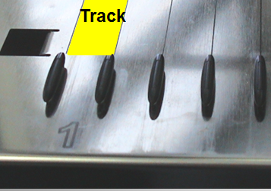
Microlab® STAR
Deck and Track System
The STAR Deck is composed of Tracks which are separated/defined by slideblocks.
Tracks are 22.5 mm wide and maintain uniformity and modularity across the STAR Deck.
Slideblocks are 22.5 mm apart
Notes:
Revise Slide to include carriers and deck related stuff.

Slide 12
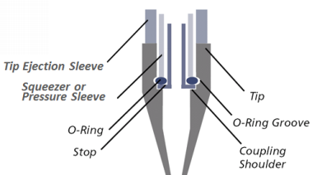
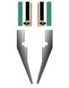
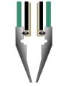
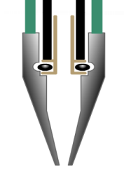
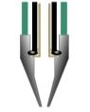
STAR Technology
CO-RE: Compression-induced O-Ring Expansion
Precise Tip Attachment with a gentle, aerosol-free tip drop-off.
High Positional Accuracy.
Tip-on and Tip type detection.
No vertical force for tip attachment or tip ejection.
Allows for multiple tip and needle sizes during the same run.
Notes:
Method Development Demonstration: demonstrate from start to finish the process of developing and running a new method.
Talk out the process and explain the overview of what is going on.

Slide 13
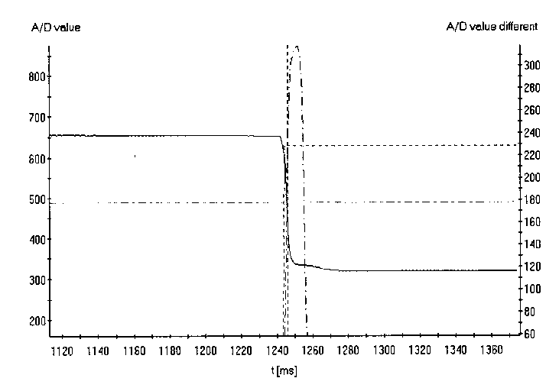


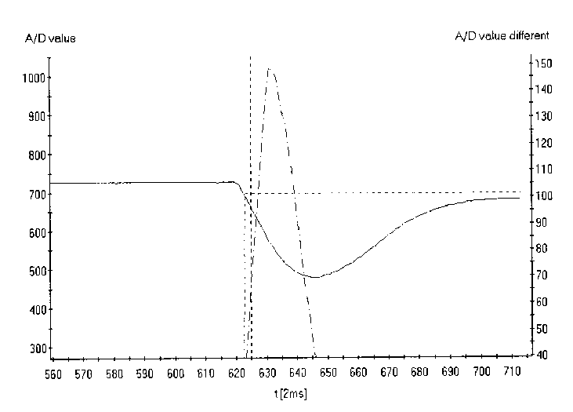
STAR Technology
Liquid Level Detection
Capacitance
cLLD
Capacitance based liquid level detection for conductive liquids with dielectric constant > 8
pLLD
Pressure based liquid level detection for all liquids. pLLD only works with new empty tips during aspiration of liquids
Pressure
Notes:
Method Development Demonstration: demonstrate from start to finish the process of developing and running a new method.
Talk out the process and explain the overview of what is going on.

Slide 14
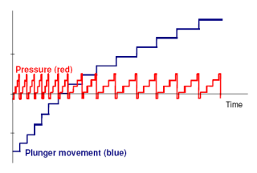
STAR Technology
Anti-Droplet Control (ADC)
A pressure sensor inside the barrel detects minute increase in pressure (red line).
Once the pressure reaches a predefined threshold, the plunger advances drawing the liquid back into the barrel (blue line).
Used for volatile liquids with extremely low viscosity and high vapor pressure like Acetone or Methanol.
* ADC is not enabled by default, an HSL library is used to activate this feature.
Notes:
Method Development Demonstration: demonstrate from start to finish the process of developing and running a new method.
Talk out the process and explain the overview of what is going on.

Slide 15
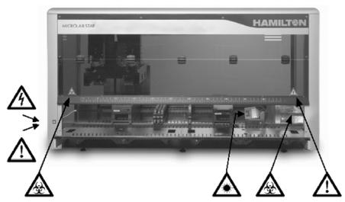
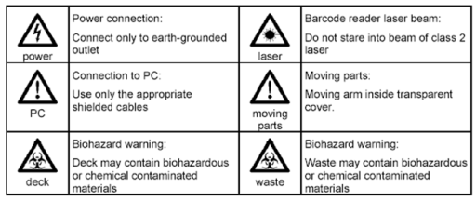
STAR Safety
Warning Labels
Warnings on the Robot
Notes:
Method Development Demonstration: demonstrate from start to finish the process of developing and running a new method.
Talk out the process and explain the overview of what is going on.

Slide 16
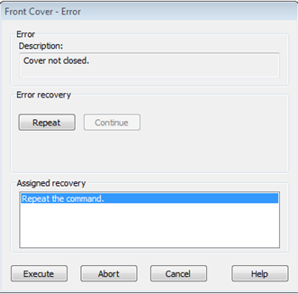
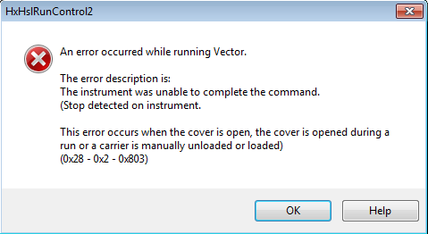
STAR Safety
General Precautions
Personal Safety
Do not place hands in the way of moving parts.
Use Good Laboratory Practices and Universal Precautions.
Wear suitable Personal Protective Equipment.
Never disable any security measure.
Notes:
Method Development Demonstration: demonstrate from start to finish the process of developing and running a new method.
Talk out the process and explain the overview of what is going on.

Slide 17
STAR Safety
General Precautions
Testing and Validation
Validation is the responsibility of the laboratory.
Perform test runs with water before using actual reagents and samples.
If pipetting aggressive liquids, use filtered tips.
Software and Hardware
The use of an uninterruptible power supply is recommended.
Guard against software viruses.
Running other applications while the STAR is running may adversely affect the operation of the STAR.
Notes:
Method Development Demonstration: demonstrate from start to finish the process of developing and running a new method.
Talk out the process and explain the overview of what is going on.

Slide 18
STAR Safety
General Precautions
Runtime and Performance
Do not switch tubes around after processing has begun.
Do not reuse tips that have been discarded into the waste.
Do not empty the tip waste while the instrument is running.
Do not leave tips on the pipetting channels for extended periods (such as overnight).
Shield the instrument from direct sunlight or intense artificial light.
Nothing on the deck should sit higher than 145mm above the deck’s surface.
The front cover is monitored by software and will abort the method if the cover is opened.
Low volume (10µl) tips do not reach the deck or the bottom of sample tubes in standard sample carriers.
50µL and 300µL tips have the same shoulder height, be sure to load tips correctly!
Notes:
Method Development Demonstration: demonstrate from start to finish the process of developing and running a new method.
Talk out the process and explain the overview of what is going on.

Slide 19
Software Installation
Tips
Before You Install
Backup work before upgrading, export methods if necessary.
Venus does not have a license agreement or a product key, so it can be installed on as many computers as needed.
When first installing, do not have STAR connected to PC until after the installation has completed.
Administrator rights are necessary to install Venus correctly. Make sure your IT group has granted those rights.
Microsoft .NET components and SQL or Oracle Database will be installed additionally to the Venus software.

Slide 20
Software Installation
Tips
During Installation
A computer reboot is required for installation to continue. Leave CD/Flash Drive in computer.
Choose default instrument type (STARlet, STAR, STARPlus).
Select 21 CFR Part 11 Settings*
Controlled access functionality
List all accessed files during method run
Use file checksums (default)
Expand and select all labware and liquid classes.
Once installed, all files point to C:\Program Files (x86)\HAMILTON.
VoV is a separate additional installation!
* Title 21 CFR Part 11 of the Code of Federal Regulations deals with the FDA guidelines on electronic records and signatures and defines the criteria under which electronic records and signatures are considered to be trustworthy, reliable and equivalent to paper records

Slide 21
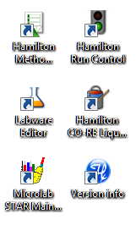
VENUS Software
Components
You can create a New Method from the Method Editor icon. From the Method Editor you can launch:
The Labware Editor to define new labware.
The Liquid Class Editor to define new liquids.
Run Control to execute your Methods.
Outside of the Method Editor you can launch:
The Liquid Class Editor (can be run in conjunction with the Method Editor/Run Control).
Star Maintenance & Verification for maintaining the STAR.
Keep in mind: The Method Editor becomes non-functional if Run Control or the Labware Editor are open.

Slide 22
VENUS Software
Maintenance and Verification
Usage
Provides an interface to run periodic routines ensuring safe and reliable operation of the STAR instrument and it’s accessories.
Maintenance Intervals
Daily: Recommended at beginning of day.
Weekly: Recommended at the end of the week before shut-down
Every 6 months: Preventive service maintenance carried out by a service engineer – includes Volume Field Verification (VFV)
*Maintenance Notes
Always clean O-Rings with DI water.
Always clean the deck with non-corrosive reagents
Always treat tip waste as biohazardous.

Slide 23
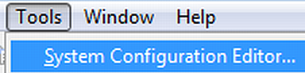
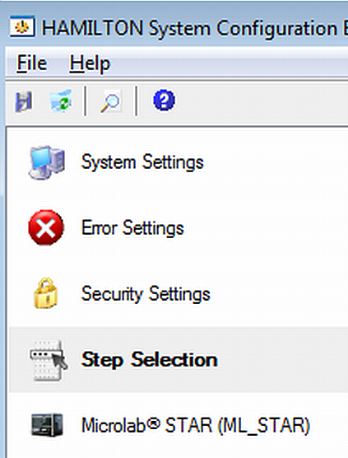
Software Installation
Configuring Venus
System Settings
Sample Tracking, Database Connection, Email Server
Error Settings
Email notification, Program execution when error occurs
Security Settings
File Checksum Verification, Function Protection, Audit Trail, Authentication System, List Used Files
Step Selection
Set General and Smart Steps visible or hidden in Toolbox
MICROLAB ® STAR (ML_STAR)
Maintenance settings (optional, warning, or mandatory) Simulation Configuration, ML_STAR Step Selection

Slide 24
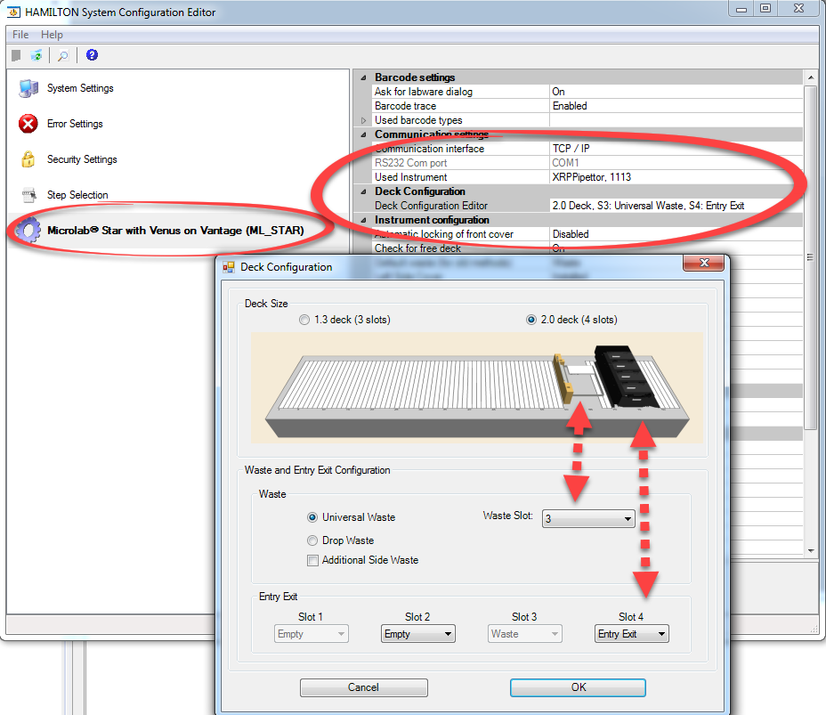
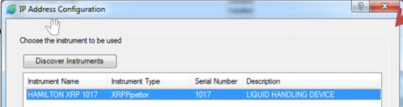
Software Installation
Configuring VoV
Deck Configuration
Set size without extra software tools.
Waste and Entry Exit configuration
Adjustable to numerous combinations
The instrument connection is set in System Configuration Editor through a TCP/IP connection (Ethernet).

Slide 25

Building a Method
Creating a New Method
File -> New -> Method
Add labware to the deck.
Create or modify sequences if needed.
Put steps together to build the method.
Run the method.
Edit and rerun the method if necessary.

Slide 26
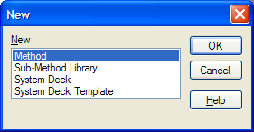
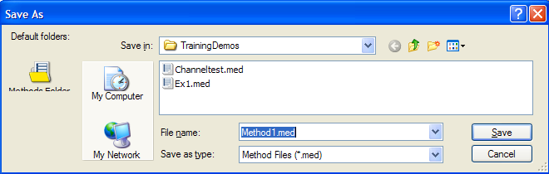
Building a Method
Creating a New Method
Creating a New Method
Launch the Method Editor
Select New > Method
Provide a File name and Save
An empty Deck Layout with the same name is created and associated with the new Method you just created.

Slide 27
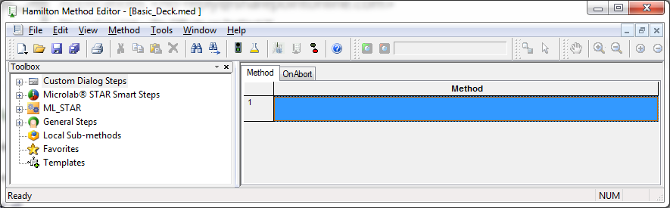
Building a Method
Software Overview
Deck Layout
Editor
Method
Editor
Save/Save All
Toolbox
Run Control
Canvas
Notes:
Make a software overview slide!

Slide 28
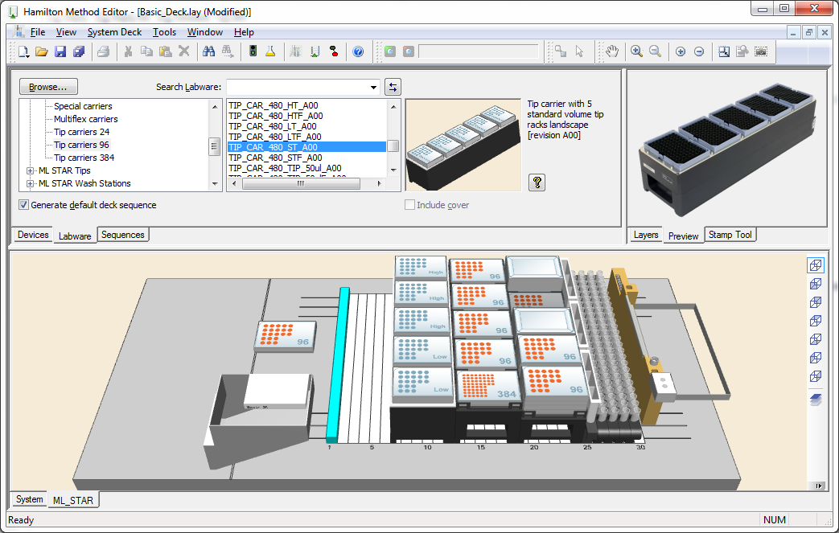
Building a Method
Adding Labware
Adding Labware to the Deck Layout
Switch to the Labware Editor.
Select labware type.
Click the name, the 3d model or the picture and drag onto the deck.

Slide 29
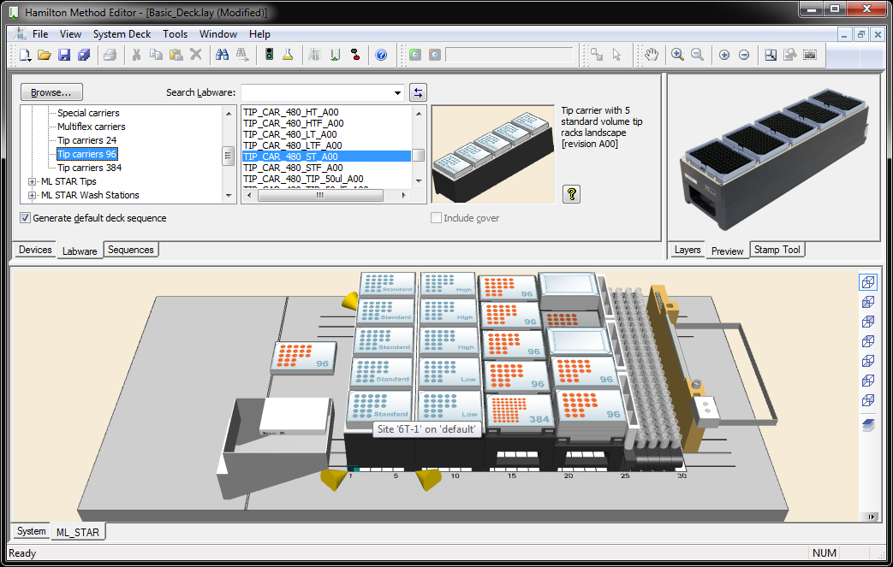
Building a Method
Adding Labware
Adding Labware to the Deck Layout
As you drag the labware onto the deck, pay attention to the track number (listed in the tooltip) and the Yellow locators, this snaps the labware into the deck.
Save early and often!

Slide 30
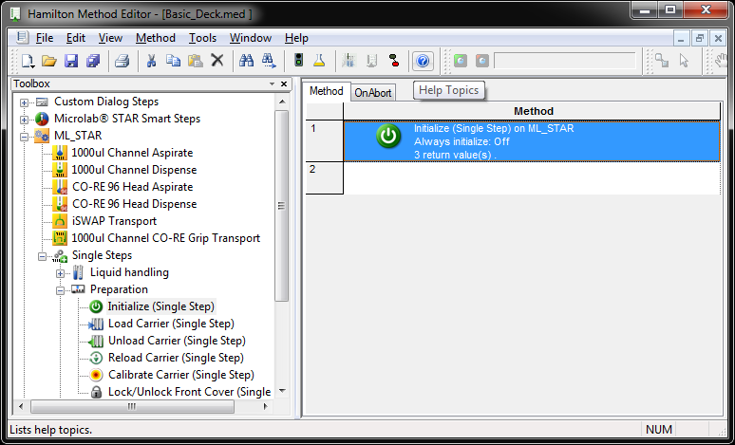
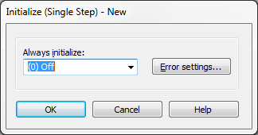
Building a Method
Adding Steps
Adding Steps to Canvas
Switch to the Method Editor.
Click through toolbox dropdown and select Initialize.
(ML STAR -> Single Steps - > Preparation -> Initialize)
Drag step from toolbox and place on Canvas.
Click “OK” on parameter box that pops up.

Slide 31
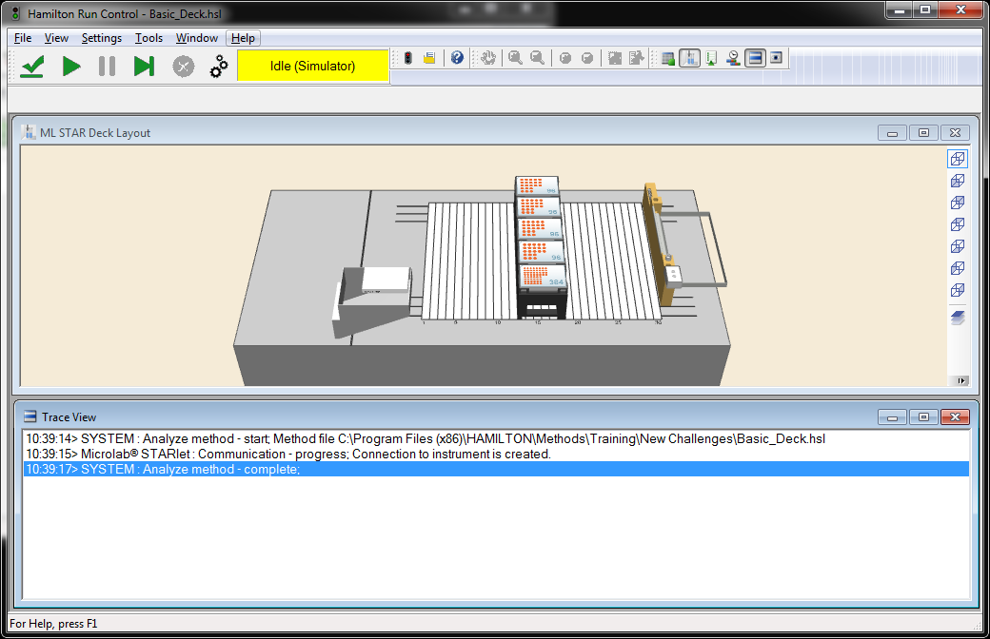
Building a Method
Running a Method
Executing a Method in Run Control
Click on the “Green Light” Icon to launch Run Control.
Click the green “Play” Button to run the method.
Observe the trace view where commands are populated.
Close the window once completed to return to the Method Editor.

Slide 32
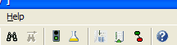
Building a Method
Editing
Toggle between the Method editor and Deck editor.
To change a Method Step, double-click it, which will open the Step’s dialog window.
Save early and often!
Re-run to verify changes made to the method.
Activate Deck
Layout Editor
Activate Method
Step Editor

Slide 33
Building a Method
Adding Labware
File -> New -> Method
Add labware to the deck
Create or modify sequences if needed
Put steps together to build the method
Run the method
Edit and rerun the method if necessary

Slide 34
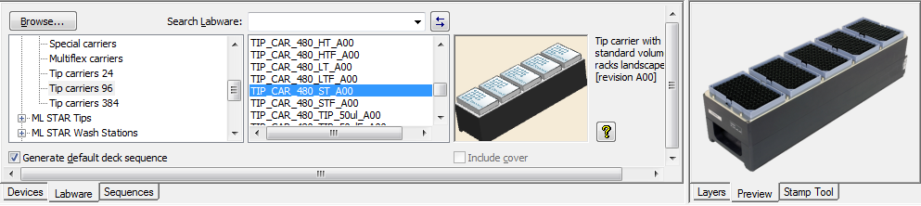
Deck Layout Editor
Deck Editor Tabs
Creates a System Deck Layout representing the instruments, devices, and labware that will be used in the Method
Devices tab
Adds a STAR system to the environment if no default deck layout is specified.
Labware tab
Adds and positions Labware on Deck Layout.
Sequences tab
Edits or creates Sequences associated to labware added.

Slide 35
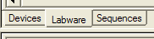
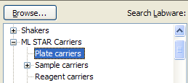
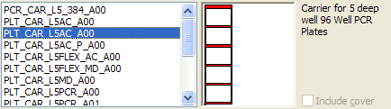
Deck Layout Editor
Adding Labware
Switch to the "Labware" tab.
Select / expand the labware category.
Drag and drop labware to the desired location on the deck.

Slide 36
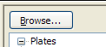
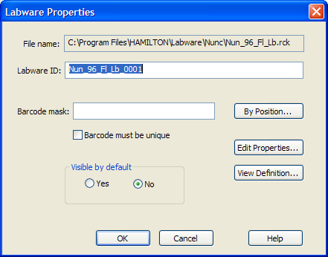
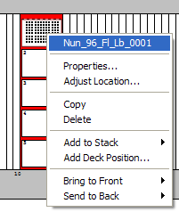
Deck Layout Editor
*Use Hamilton Support Software (found under the Tools menu) to add or remove labware from the list
Labware Details
Additional Properties
To find uncategorized labware, click the “Browse” button to navigate to the labware file.
When labware is added, a new Labware ID is automatically generated from the labware name.
Right-clicking any labware on deck allows one to adjust the labware location, stack labware, or to view specific labware properties.
*In the labware properties window, the Labware ID can be edited.

Slide 37


Deck Layout Editor
Hands-On Exercise
Challenge 1
Create a New Method and Build a Deck Layout

Slide 38
Method Creation
Building a Method
File -> New -> Method
Add labware to the deck
Create or modify sequences if needed
Put steps together to build the method
Run the method
Edit and rerun the method if necessary
(Sequences will be covered later in the training)

Slide 39


Method Editor
Associating a Deck Layout
Normally, a Deck Layout is generated automatically when a new Method is created.
If a Deck Layout is already open, then a newly created Method will use the open layout instead of generating a new one.
A Method can also be manually associated to a different Deck Layout.
Open the Method then click Method -> Instruments and Smart Steps
Browse to the layout file you want to associate with the Method.

Slide 40





Method Editor
Method Editor Settings
View Settings
The View Menu to change how the method editor looks.
Step detail can be changed with these settings:
Icon and Description is most detailed, but most busy.
Icon and Stepname is good for a quick “birds eye” view of a method.
Icon just shows the icon of the step and is not recommended.

Slide 41

Method Editor
Method Editor Settings
Toolbar Settings
Right-Clicking the toolbar allows the User to select windows for viewing and editing the method and its properties. The most commonly used are the “Toolbox” and “Variables and Constants.
Additionally it allows for the User to select what toolbars appear across the top of the screen. The most commonly used are “Standard” and “Zoom”

Slide 42
Method Editor
Organizing Your Code
Organizing Methods
Method organization is an essential skill that allows for our Methods to be more human readable and easier to troubleshoot and debug. It also allows for better documentation within the method and better readability between different Users, some who may have never worked with the system before and will need a basic understanding of how the method works.
There are two useful tools for organizing and documenting our steps. They are:
Commenting – Inserting User readable descriptions or text into the method that allows Programmers and Users alike to “make sense” of what functions, variables or other parameters are in the method.
Grouping – A means of creating a collapsible section of steps that encapsulate a particular function or section of the method. A Group contains a comment section that allows the method developer to describe the function/purpose of the Group.

Slide 43



Method Editor
Organizing Your Code - Commenting
Commenting Steps/Functions within Methods
Comments are ways of adding “notes” to your method. They appear in the method as steps and can be traceable.
One can find them in the General Steps tab.

Slide 44




Method Editor
Organizing Your Code - Grouping
Grouping Steps within Methods
Grouping is a useful tool for making methods more modular and human readable.
How to Group Steps
“Shift” select the steps to be grouped.
Right click and choose “Group Selection”.
Type a description of the group and select “OK”.
Now the grouped steps appear in a segment that can be collapsed or expanded with the +/- box.

Slide 45

Run Control
Overview
Run Control is a component of Venus used to compile and run methods. It can either connect to a physical instrument or be used in simulation. When using Run Control, the Method Editor becomes locked out as to prevent modifications of a currently running method.

Slide 46
Run Control
Simulation and View Settings
Single Step
Abort
Controls
Start
Pause
Verify

Slide 47
Run Control
Simulation and View Settings
Enable Simulation Here
Run Status
Change View Settings Here

Slide 48


Run Control
Error Recovery
If a method is aborted and tips are still attached, a dialog window appears and asks the User if the X-Arm is safe to move and eject the tips.
If a method is aborted and a plate remains in the iSWAP gripper, a dialogue window appears with controls to move the iSWAP to a collision-free location and release the plate safely.
Notes:
Method Development Demonstration: demonstrate from start to finish the process of developing and running a new method.
Talk out the process and explain the overview of what is going on.

Slide 49
Run Control
Hands-On Exercise
Challenge 2
Putting together Steps for a Method

Slide 50
Method Creation
Overview
File -> New -> Method
Add labware to the deck
Create or modify sequences if needed
Put steps together to build the method
Run the method
Edit and rerun the method if necessary

Slide 51
Sequence Editor
Sequence Concept
Sequences
Sequences act as a “road map” telling the robot where a pipetting behavior or transport will start and end.
Represent positions (x-y-z) on labware, but are not necessarily labware dependent.
Flexible and limitless – completely modifiable/editable in the Sequence Editor and on-the-fly during method execution.
Can span across multiple labwares and labware types.
Editable by some Venus steps, HSL Libraries and with several tools in the Sequence Editor such as the Stamp Tool.
Used by both Pipetting and Transport steps.
Notes:
FIX THIS SLIDE

Slide 52



Sequence Editor
Creating Sequences
Creating Sequences by Adding Labware
Sequences can be automatically added to the system when adding new labware.
In the Labware tab of the Deck Layout Editor, make sure that “Generate default deck sequence” is checked.
Once a labware has been added to the deck, a default sequence is generated. It’s name is the same as the Labware ID of said labware.
If the Labware ID is modified, the corresponding default sequence name is modified as well.

Slide 53

Sequence Editor
Creating Sequences - Overview
Creating Sequences by Selecting Positions
Sequences can be created manually by selecting positions using various tools.
Before you start to click “Clear Selected” to clear out any possible sequence selections.
Sequences can then be selected via:
Rubber Banding
Using the Stamp Tool
Using the Single Position selection
When completed, “Save As” and give it a unique name.

Slide 54




Sequence Editor
Creating Sequences – Rubber Banding
Words of Caution
Continuing to “Rubber Band” or continuing to click will append those positions to the sequence.
Make sure to always click “Clear Selected” before starting to build a new sequence.
Nunc plate was already selected when positions on Costar plate were Rubber Banded.
First column was clicked twice!

Slide 55





Sequence Editor
Stamp Tool
What is the Stamp Tool?
The Stamp Tool is a software function that allows the developer to build sequences much faster.
Using the “Probe Head” list, the developer can select the pipetting device they would like to build the sequence for.
The Stamp Tool allows for a selection of what pipetting device is used, as well as a single position selector for creating hit-picked sequences.

Slide 56




Sequence Editor
Sorting and Editing
How to edit or rearrange Sequences
After selecting from the list of sequences the sequence you wish to edit, click the “Advanced…” button in the “Sequences” tab to bring up the “Edit Positions” window.
The Labware ID, Position and X-Y-Z Coordinates are then listed in this window.
Using the sorting tools, stamp tool or deleting positions, a sequence can be edited in many ways.

Slide 57








Sequence Editor
Example Sequences
Column1x4
Platesx4
Odd_Blanks
Pick_List
Quad384_by_96
A1 Quadrant
A2 Quadrant
B1 Quadrant
B2 Quadrant

Slide 58
Sequence Editor
Hands-On Exercise
Challenge 3
Defining and using sequences

Slide 59


Sequence Editor
Handling Sequences
Clicking a sequence name from the “Deck Sequences” list selects the sequence.
Right-clicking brings up an option menu, where the sequence can be renamed, deleted or have it’s properties listed.
The “Properties” menu will list labware associated with the sequence.
One “System Defined Sequence” is created for each tip type.

Slide 60


Sequence Editor
Verifying Sequences
The “Play Sequence” buttons will animate the order of a sequence, either based on current sequence order or the Stamp Tool selected.
The “Validate…” button will check all sequences to verify that the labware associated to them exist.

Slide 61





Sequence Editor
Using Sequences in a Method
Sequences are used within Method Steps to describe a source or a destination for pipetting and transport

Slide 62




Sequence Editor
Channel Assignments
When pipetting the 1st sequence position is assigned to channel 1, the 2nd position to channel 2 and so on until all channels or positions have been assigned.
Returning to the same sequence, the 9th position is assigned to channel 1, the 10th position assigned to channel 2 and so on until
all channels or positions have been assigned.

Slide 63

Sequence Editor
Pointers
Pointers keep track of the available positions in a Sequence
The "Current_Position" pointer always points to the next available position (set to index #1 when first created)
Current Position
The End_Position pointer always points to the last available position (set to the last-index # when first created)
End Position

Slide 64

Sequence Editor
Sequence Counting
Actions, such as pipetting and transport, always start at the "Current_Position" and follow the index order.
If the Sequence Counting is set to Automatic, then the "Current_Position" pointer will follow along as positions get processed.
Current Position
In the illustration on the right, the first eight positions were processed and the "Currrent_Position" pointer now points to index #9.
End Position

Slide 65

Sequence Editor
Sequence Counting
If the Sequence Counting is set to Manual, then the "Current_Position" pointer will not change as positions get processed.
Current Position
In the illustration on the right, the first eight positions were processed and the "Currrent_Position" pointer will continue to point to index #1 because we are not incrementing the sequence. In the next round of processing, the "Current_Position" pointer will remain at index #1 and the processing will then begin at index #1.
End Position

Slide 66








Sequence Editor
Sequence Counting
Rgt: Start at pos 1
Plate: Start at pos A1
Rgt: Start at pos 1
Plate: Start at pos A2
Rgt: Start at pos 1
Plate: Start at pos A3

Slide 67
Sequence Editor
Sequence Processing
When all positions are processed, the "Current_Position" pointer has no next available position to point to and is set to zero
Current Position
In the illustration on the right, all positions were processed and the "Current_Position" pointer now points past the "End_Position" pointer indicating that the Sequence has no positions left to process.
End Position

Slide 68



Sequence Editor
Sequence Errors
If all positions in a Sequence have been processed and the method attempts to pipette to the same sequence, an error occurs and the Method is aborted.
To avoid this error or to start over from the beginning of a sequence:
Use the "Sequence: Set Current Position" step in the General Steps list.

Slide 69



Sequence editor
Modifying Sequences
Using the steps Sequence: Set Current Position and Sequence Set End Position we not only have the ability to reset a sequence for reuse, but can also modify the sequence during runtime for other purposes.
In fact, the "Current Position" can be set to any position within the sequence; the next step will start processing from this position.
Similarly, the "End Position" can be set to any position within the sequence and the next steps will end processing at this position.

Slide 70
Sequence Editor
Hands-On Exercise
Challenge 4
Defining and Using Sequences

Slide 71

Loops
Overview
What is a Loop?
The Loop Step is used to repeat (or iterate over) specific steps inside the loop body.
There are 4 different types of loops.
Loop a fixed number of times.
Loop while some conditional statement is true/false.
Loop over and increment a sequence.
Loop over a file until all records have been read.

Slide 72



Loops
Usage
Under the General Steps drop down, the Loop step can be found.
Drag the step onto the Method Editor Canvas.
Once the parameter window pops up, select the loop type to be used and enter the necessary parameters.
Click okay and the Loop will be added.
Notice the loop appears like a group, where the +/- sign allows for it to be collapsed and expanded.
Steps that need to be looped can be placed inside of the loop.
Once the method executes and reaches the loop, it will loop until specified conditions are met.

Slide 73




Loops
Examples
Repeat the step 12 times
Repeat forever or until the step Loop-Break is encountered
Repeat the pipetting steps until all sequence positions in TargetPlatesX4 are processed.
Read each record from the work list until the end-of-file is reached

Slide 74




Loops
Looping over a Sequence
Iterate over sequence
Repeat the steps inside the loop until the “Controlling” sequence runs out of positions (i.e. reaches it’s End Position)
=
never = No resetting of selected sequence.
before loop = Current position of selected sequence is set to 1 before Loop starts.
after loop = Current position of selected sequence is set to 1 after Loop completes.
before & after loop = Current position of selected sequence is set to 1 before & after Loop.
*When more than one sequence is checked as Controlling then the Loop will end when the smallest sequence runs out of positions.

Slide 75



Loops
Loop Breaks and Counters
To force a Loop to end prematurely, use the Loop Break step. Processing continues with the next step after the End Loop.
The Loop counter variable created by the Loop step automatically keeps count of the number of iterations.
The loop counter is set to 0 before Loop execution starts, and is incremented by 1 every time the Loop body is entered.
Loops can contain other Loops
In this example, the outermost loop will perform the full volume aspiration 4 times, while the dispense is captured in the innermost loop, performing a multi-dispense.

Slide 76
Loops
Hands-On Exercise
Challenge 5
Repeat steps with Loop-End Loop
Challenge 6
Repeat steps with Loop-End Loop

Slide 77




Variables
Overview
Variables are containers representing information that changes or is unknown at the time when the Method is written (e.g. the number of samples to process or the volume to be dispensed into each well).
Variables are created by providing a name and an initial value. Use general steps: Assignment and Assignment with Calculation to do this.
Variables can also be created directly within many steps

Slide 78
Variables
Data Types
Variables created within Venus can generally have one of three different data types.
A data type is a property of a variable telling the computer (and the User!) what kind of data is going to be processed so it knows what to do with it.
There are 3 main data types in Venus:
Integer (int) – A whole number between -2,147,483,648 and 2,147,483,647.
Examples: -2, 1000, -324523, 5
Float (flt) – Also known as a “floating point” represents a number with a decimal point up to 6 significant decimal digits.
Examples: 1.03, 3.14, 0.04534, 8.08
String (str) – A character string, or essentially, any text. Must be enclosed in “” to be recognized as a string.
Examples: “Hamilton Robotics”, “Samples”, “This is a sentence.”, “C:\\Program Files (x86)\\HAMILTON”

Slide 79
Variables
Conventions and Caveats
Variable names are case-sensitive and must begin with a letter or underscore ( _ ).
Once defined, variables appear in the drop-down list of input fields.
Inside text strings, a single backslash = Escape Character (i.e. the character that follows a backslash can have special meaning:
“\t” = “tabs” “\n” = “new line” “\\” = “\” “\”” = quote marks
Example: "C:\\Program Files (x86)\\HAMILTON\\Methods\\Examples\\Worklist.xls"
For variables used in calculations:
Two integers will result in an integer:** if A = 5 and B = 2, then A/B = 2, A*B = 10
An integer and a float will result in a float: if A = 5.0 and B = 2 then A/B = 2.5, A*B = 10.0

Slide 80
Variables
Naming Conventions
What is a Naming Convention?
Once a method has been written, it will often have many different types of variables. Implementing a Naming Convention based on the Data Type will make it easier to keep track of variables in the system and allow other Users and Developers more easily understand what is going on in the program.
Examples:
For Naming Integers – Start the variable name with int. So for a variable that symbolizes a number of samples, a good name would be intSampleNumber.
For Naming Floats – Start the variable name with flt. So for a variable that symbolizes a aspiration volume, a good name would be fltAspirationVolume.
For Naming Strings – Start the variable name with str. So for a variable that symbolizes a file path, a good name would be strFilePath.
For Naming Arrays – Start the array name with arr. So for an array that contains aspiration volumes, a good name would be arrFltAspirationVolumes.

Slide 81



User Input / Output
Usage with Variables
Located under General Steps, User Input and Output create Dialog Windows prompting Users for information.
Variables are assigned in the “Output Text” parameter boxes, will be updated based on User Inputs/Outputs.
Square brackets “[ ]” indicate that entering a value in that field is optional.
Text entries like the “Dialog Title”, “Prompt” and any text in the “Output Text” must be in String Format.

Slide 82




User Input / Output
Parameters
Title for Dialog Window.
Buttons to include with the Dialog Window.
Options -
1 = OK
2 = Cancel
3 = Abort
4 = Retry
5 = Ignore
6 = Yes
7 = No
Input a variable that will store the value of the selected Button.
Input an amount of time before the Dialog Window closes and makes a Default selection.

Slide 83
Variables
Hands-On Exercise
Challenge 7
User Input and Aliquot Dispense

Slide 84

Conditionals
If/Else Statements
What is an If/Else Statement?
Used by the program to compare data and make decisions.
Works like a “Fork in the Road” allowing the program to operate in different manners based on data or instrument behaviors.
Can be nested to check multiple conditions and make compound decisions.
The “Else” part of the If/Else step is optional.

Slide 85




Conditionals
Nested If Statements

Slide 86
Conditionals
Hands-On Exercise
Challenge 8
Incorporating If/Else Statements

Slide 87


Pipetting Steps
Single Steps
Grouped under ML_STAR tab or tree dropdown.
Performs a single action.
Full range of Error Handling.
More granularity/flexibility than Gold Steps or Smart Steps.
Some not visible by default – Use Configuration Editor to enable/disable visibility.

Slide 88


Pipetting Steps
Gold Steps & Smart Steps
Gold Steps
Grouped under ML_STAR tab or tree dropdown.
Perform compound actions/steps.
Tip Counting included in pipetting steps.
Full range of Error Handling.
Smart Steps
Grouped under STAR Smart Steps tab or tree dropdown.
Performs compound actions through use of “Wizard” style interfaces.
Tip Counting and Sequence Handling included.
Limited range of Error Handling.

Slide 89

General Steps
The General Steps tab or dropdown form a group hardware independent steps that perform a variety of functions.
Functions -
Basic Sequence handling functions.
User Input/Output Dialogs.
Conditionals using If/Else.
Basic File handling.
Basic Communication commands.
Basic Array handling functions
Timer and Timer Manipulation commands.
Parallel Process handling.

Slide 90



Tip Handling Steps
Tip Pickup and Tip Eject
Tip Handling steps can be found under ML_STAR tab or tree dropdown.
Require a Tip sequence to perform action. Sequence can either be a “System Managed Sequence” or a special Tip sequence defined by programmer.
Sequence counting can be “Manual” or “Automatic” and should only be set to “Manual” when the tips will be ejected to the same location as Tip Pickup.
Tips by default are ejected to system specified waste locations, but a specific eject sequence can be selected as well.

Slide 91
Pipetting Steps
Liquid Level Detection (LLD)
Liquid Level Detection is technology used by the STAR channels to detect the surface of a liquid. Used in both aspiration and dispense (depending on the dispense mode) to achieve greater pipetting accuracy and to reduce the amount of liquid present on the outside of the tips. There are two types of LLD present on the Hamilton STAR.
Capacitive Liquid Level Detection (cLLD) can detect liquids that are polar/conductive. Available on 1000µL Channels and the 96MPH in positions A1, B2, G11, and H12.
Pressure Liquid Level Detection (pLLD) can detect all types of liquids, both polar and non-polar, however, is only available during aspiration with dry tips.

Slide 92

Pipetting Steps
1000µL Channel Aspirate
Aspiration Overview
Located in ML_STAR tab or tree dropdown.
Requires a source sequence.
Sequence counting can be Automatic or Manual.
Volumes can be hard-coded or can use a variable.
Individual volumes can be specified for each channel.
Aspiration parameters are directly related to the 1000uL Channel Dispense.
Pipetting Behaviors, such as LLD settings and pipette position can be specified.

Slide 93


Pipetting steps
Aspiration Modes
Aspiration (default) (0) Blow-Out Air is aspirated while the tips are above Liquid Level and is then used post-dispense to dispense the remaining liquid from the tip.
Consecutive aspiration (1) * Allows for an additional aspiration to follow up a previous one by not aspirating Blow-Out Air again.
Aspirate all (2)
Used when the aspiration volume is greater than calculated container volume. The tip will follow the liquid level (if enabled) to the container bottom and remain there until requested volume is aspirated - MAD is deactivated so as to avoid Liquid Level detection errors.
*Cannot be 1st Aspiration
**Filters Optional
Tip Shoulder
**Filter
Blow-out Air
Liquid
Transport
Air

Slide 94

Pipetting Steps
Aspiration Pipetting Behaviors
During the Aspiration, we want to optimize our Pipetting Behavior to ensure the tips are submerged throughout the duration of the aspiration.
Capacitive LLD: Enables and sets sensitivity for cLLD. Appropriate for polar/conductive liquids
Pressure LLD: Enables and sets sensitivity for pLLD. Appropriate for non-polar/non-conductive liquids or Labware.
Fix height from bottom [mm]: When both LLD’s have been disabled, allows the programmer to specify a fixed height from the labware bottom where the aspiration occurs.
Submerge Depth: When either LLD’s are enabled, allows programmer to specify the pipetting depth (mm) below detected liquid surface.
Max height difference [mm]: When both LLD’s are selected, allows the programmer to specify the tolerance of the calculated difference between cLLD and pLLD. If the difference is greater than the tolerance an error will occur. Useful to detect overly foamed reagents.

Slide 95


Pipetting Steps
Advanced Aspiration Behaviors
Located under the “Advanced” button in the 1000µL Channel Aspirate, additional Pipetting Behavior parameters can be found.
Liquid following during aspirate and mix: - Enables/Disables Liquid Following.
Pre-rinsing/Mix settings
Cycles: Number of mixing cycles.
Mix position [mm]: Sets the immersion depth below the set aspirate/dispense depth.
Volume [µl]: Mixing volume; it is recommended to use half or more of the pipetting volume.

Slide 96

Pipetting Steps
1000µL Channel Dispense
Dispense Overview
Located in ML_STAR tab or tree dropdown.
Requires a dispense sequence.
Sequence counting can be Automatic or Manual.
Volumes can be hard-coded or can use a variable.
Individual volumes can be specified for each channel.
Dispense mode usually set by Aspirate step.
Pipetting Behaviors, such as LLD settings and pipette position can be specified.

Slide 97



Pipetting Steps
Dispense Modes
Jet Dispense – Pipetting tip dispenses above liquid surface.
Jet empty tip: Tip is fully emptied of liquid using blow-out air.
Jet part volume: Tip is partially emptied without blow-out air. Useful for multidispensing.
Surface Dispense – Pipetting tip dispenses below liquid surface.
Surface empty tip: Tip is fully emptied of liquid.
Surface part volume: Tip is partially emptied. Useful for multidispensing.
*Jet & Surface: Obsolete – do not use.

Slide 98

Pipetting Steps
Dispense Pipetting Behaviors
During the Dispense, the Pipetting Behavior should be optimized to ensure the tips are in an appropriate position.
Fixed height from bottom: Sets the dispense position relative to the container bottom.
Side touch: Enables side touch so the pipette will dispense at the container wall. Positioning of tip is defined within the labware's Container Definition.
Capacitive LLD: Enables and sets sensitivity of cLLD. Appropriate for polar/conductive liquids.
Submerge depth [mm]: Sets the immersion depth below the detected liquid level.
Touch off *: Enables bottom touch off. Useful for pipetting low volumes to empty wells.
Dispense position above touch [mm]: Sets the distance the channels will move up in Z after touching the container bottom.
* Dispenses at either the physical bottom or the Max Pipetting Depth as defined in the Labware Definition.

Slide 99

Pipetting Steps
Advanced Dispense Behaviors
Located under the “Advanced” button in the 1000µL Channel Dispense, additional Pipetting Behavior parameters can be found.
Liquid Class: A different liquid class can be specified in the dispense than used in the aspirate.
Z – Move after Step*:
If “normal” is selected, the channels will move to a maximum traverse height each time they move.
If “minimized” is selected, the channels will move to a minimal traverse height set by the Labware Definition each time they move.
* Make sure all labware on deck is below 145mm!

Slide 100
Pipetting Steps
Hands-On Exercise
Challenge 9
Pipetting Steps

Slide 101


Pipetting Steps
Individual Volumes
Found in both the Aspirate and Dispense steps, Individual Volumes allows for individual pipetting volumes to be specified for each channel. The volumes can either be hardcoded, use a variable, or an array of variables.
Volume [µL]: Enter the individual volume or select a variable representing the volume.
Add / Change >>: Press this button to add or change the volume of the selected channel to the value in the Volume [µL] field.

Slide 102



Pipetting Steps
Method Editor
Channel Settings
The Channel Settings button, available in both Aspirate and Dispense steps allows for special selections of channel patterns and channel usages.
Channel selection: All deselected channels will be disabled from the corresponding step.
Channel selection as variable: Enables usage of a channel pattern variable.
Channel variable: A string specifying the channels to be used.
0 = unused, 1 = used
Channel use: Specifies the ordering system used by the channels.
(1) All sequence positions: Remaining channels are used to process all sequence positions.
(2) Channel pattern: Sequence positions corresponding to deactivated channels are not processed but are “consumed”.

Slide 103







Pipetting Steps
Method Editor
Channel Pattern Variations
Channel Variable
“10111101”
Channel Pattern
All Sequence Positions
OR
“01100110”

Slide 104
Pipetting Steps
Hands-On Exercise
Challenge 10
Performing a Serial Dilution with Controls

Slide 105





Transport Steps
CO-RE Grippers
CO-RE Grippers are tools that can be picked up by the 1000µL Channels and allow for lids and plates to be transported within the deck space.
The Safe Traverse Height is the same as with tips, 145 mm above the deck.
CO-RE Gripper Tools must be added to deck layout like other labware.
Newer STAR instruments will use the “OnWaste” CO-RE Gripper Tool, whereas older models use the “AtWaste” CO-RE Gripper Tool.
AtWaste
OnWaste

Slide 106


Transport Steps
VoV Difference
Quad Core Grippers
Quad Core grippers are accessed by FOUR independent 1000ul Channels
Additional Channels needed to overcome the tensioning spring, which prevents plate drops on power loss (linear Y-motors).
CoRe grip Commands are used as normal – the “extra” channels will not be referenced in the sequence or show in the trace file
Depending on VoV version, the “front” channel is either the 2nd (front of rear grip) or 4th (true front) used.
Read Barcode function currently not supported in VoV
Notes:
HIDE for ONS

Slide 107


Transport Steps
CO-RE Gripper Get Plate
1000µL Channel CO-RE Grip Get Plate
Transport Mode: Allows for Plates, Lids or Lidded Plates to be transported.
Grip height: Distance below top of labware where plate is gripped.
Plate Sequence: Typically the Source transport sequence. *Make sure the sequence counting is the correct usage!
Advanced Parameters
Grip force: Specifies how hard the plate is gripped.
Check if plate exist: CO-RE Grips will “tap” on plate to check if it is present or not.

Slide 108


Transport Steps
CO-RE Gripper Place Plate
1000µL Channel CO-RE Grip Place Plate
Transport Mode: Allows for Plates, Lids or Lidded Plates to be transported.
Plate Sequence: Typically the Destination transport sequence. *Make sure the sequence counting is the correct usage!
Eject tool when finish: Allows for the CO-RE Gripper Tools to be ejected or not after the transport has completed.
Advanced Parameters
Plate press on distance: Specifies how far the plate is pressed down onto the destination location.
Check if plate exist: CO-RE Grips will “tap” on plate to check if it is present or not.

Slide 109

Transport Steps
Sequence Definitions
Sequence Definitions for Transport Steps
To keep transports simple, it is recommended to build custom sequences for transports.
Transport sequences should be 1 position per labware and can span across multiple labwares (such as a stack of plates).
When selecting single positions across a carrier, use the single position selector.
When selecting single positions within a stack, use the rubber band tool.*
*Remember clicking and then rubber banding will append the two selections together! Always double check your sequences!

Slide 110
Method Editor
Hands-On Exercise
Challenge 11
Plate Stacking

Slide 111


Transport Steps
iSwap
Internal Swivel Arm Plate Handler
A robotic arm that transports labware within the deck space, and can deliver plates 60mm outside of the instrument.
The Safe Traverse Height is the same as Tips and the CO-RE Grippers, 145mm.
A torque sensor monitors how tightly the labware is gripped.
Can work in landscape or portrait and can rotate plates between different configurations.

Slide 112

Transport Steps
iSWAP Get Plate
iSWAP Get Plate
Plate Sequence: Typically the Source transport sequence. *Make sure the sequence counting is the correct usage!
Movement: Allows for the iSWAP to either make a simple “To carrier” movement, or a “complex movement” for off deck transportation.
Transport Mode: Allows for Plates, Lids or Lidded Plates to be transported.
Grip height: Distance below top of labware where plate is gripped.
Grip mode: Allows the plate to be picked up in either portrait or landscape

Slide 113

Transport Steps
iSWAP Place Plate
iSWAP Place Plate
Movement: Allows for the iSWAP to either make a simple “To carrier” movement, or a “complex movement” for off deck transportation.
Plate Sequence: Typically the Destination transport sequence. *Make sure the sequence counting is the correct usage!

Slide 114



Transport Steps
iSwap – Complex Movements
A Complex Movement is a specialized type of transport that can move labware outside of the deck space. The parameters for Complex Movements can be found in most iSWAP steps.
Retract distance [mm]: Specifies if iSWAP will approach the target with an outstretched or bent arm. If the Retract Distance is…
> 138mm: Approaches target with outstretched arm < 138mm: Approaches target with arm bent.
Lift-up height [mm]: The lift-up height for a collision-free insertion or extraction.
Labware orientation: The direction the iSWAP approaches labware. Make sure the correct direction has been selected, based on if the iSWAP is picking up the plate with an “Inverse Grip”. If the iSWAP’s grip direction and the labware orientation do not match, an error will be generated and the transportation will fail.

Slide 115



Teaching a Position
What is Teaching?
Teaching is manually guiding a channel or iSWAP to a particular location on deck and instructing the STAR to “remember” the coordinates.
In Deck Layout, right-click on a labware of interest to bring up the context menu and select Adjust Location.
On the Adjust Labware Position window, click on Move Probe.
Select a teaching tool from the list.

Slide 116

Teaching a position
Teaching with iSWAP
Select a labware position on deck that matches the destination labware.
Give the correct orientation (portrait or landscape)
Enter the correct grip parameters.
The approximate target position should be close to the desired coordinates of the destination.
Enable Complex movement if necessary.
Stretch the iSWAP arm if necessary.
Make sure that the correct labware orientation is selected.

Slide 117
Teaching a Position
Teaching with the iSWAP
Teaching is manually guiding a channel or iSWAP to a particular location on deck and instructing the STAR to “remember” the coordinates.
In Deck Layout, right-click on a labware of interest to bring up the context menu and select Adjust Location.
On the Adjust Labware Position window, click on Move Probe.
Select a teaching tool from the list.

Slide 118
iSWAP
Hands-On Exercise
Challenge 12
iSWAP Transport

Slide 119




Arrays
What is an Array?
Arrays are variables that hold multiple values of the same data type (numbers, strings, sequences).
Arrays resemble a grocery list or any other numbered list.
Created using the General Step: Array: Declare/Set Size.
Structurally consists of two parts, an Index and an Element.
The Index represents the “numbering” of the list.
The Element represents the data that is stored at that index.
Arrays, like variables, can be used in place of specific values.
Sometimes, Arrays are automatically created by certain steps, but it is a good idea to always declare an array before you use it.
Array of Variables (Floats)
Array of Variables (Strings)
Array of Sequences

Slide 120

Arrays
An Array Example

Slide 121






Arrays
Declaring and Adding Data to Arrays
Array: Declare / Set Size creates a new array.
Check “Empty array” or provide a “New size”.
Array: Set At fills one array element with a value.
Select “Add to end of array” to build the array.
or
Enter a specific Array index to store the value in that array element.

Slide 122
Arrays
Array Rules
Referencing an Array Element
An array element reference is composed of:
An array name (follows the same rules as a variable name).
Followed by a “[“ (an open bracket).
Followed by an index (a positive integer or a variable).
Followed by a “]” (a closed bracket).
Additional rules
The Array Index is one-based (index 1 refers to first element)
One cannot use another array element as an array index.
Examples
To reference the 7th element in the array, arrIntSampleSize, the syntax is:
arrIntSampleSize[7]
To reference the N^{th} element in the array, arrStrGroceryList, the syntax is:
arrStrGroceryList[N]

Slide 123



Arrays
Using Arrays
For Volume arrays, click the “Array index dialogue button” to open the Array Index dialogue to use multiple array values.
Caveats
For Single or Gold steps in a loop, use a variable for the “Start at array index” value and increment it by the number of channels with every loop.

Slide 124





Arrays
Array: Get At – retrieve the value of an array element
Array: Get Size – retrieve index for the upper bound
Array: Copy - create a copy of an array
Array: Get at can also be accomplished using the Assignment step
=
Use the TraceArray step from the HSLUtilLib2 library to print the contents of the array to the log file
An error will occur if an array’s index is out of bounds (i.e. index is larger than the number of elements

Slide 125
Arrays
Hands-On Exercise
Challenge 13
Using Arrays Within Pipetting Steps

Slide 126

Libraries
Overview
Libraries are collections of specialized functions available to your method. Sometimes Venus does not have a particular function to accomplish a task, libraries with suitable functions can be added to the method, expanding the features and flexibility of the software.
To Add a library, click on Method dropdown menu and select Libraries… to add a library.
Examples:
File Library: File handling commands.
Math Library: Basic and advanced mathematical operations.
Sequence Library: Advanced sequence creation and handling.
String Library: Concatenate, fill, search and modify strings.
Time Library: Time & date information from computer.
Tip Counting Library: Keeps track of tip usage between runs.
Trace Library: Write directly to the trace window.
ML_STAR Library: Turn off/on ADC, MAD, clot detection.
Utility & Utility2 Library: Misc functions, GetUniqueRunID, TraceArray, TraceSequence.

Slide 127

Tip Counting Library
Overview and Usage
The Tip Counting Library is a small collection of functions allowing the method to continue using tips on partial racks from previous runs.
Usage
Add the library HSLTipCountingLib.hsl to toolbox.
Add the “Edit2” step at the very start of your method.
Add the “Write2” step at the very end of your method.
Add the “Write2” step to the OnAbort sub-method.
Notes
A separate tip counter is needed for each tip sequence.
Does not work with NTRs – use NTR library instead.
Enter a name in “quotes” or as a String variable.

Slide 128

Tip Counting Library
Edit2 Dialog Window
Adjust First and Last position (if required) in the dialogue window

Slide 129

File Handling
Overview and Commands
File Handling allows Programmers to manipulate files within Venus to either Read data from to drive the method, or to write data from the Method as a means of logging, documentation, etc.
The process is typically:
Opening a file and assigning variables to the data fields.
Defining a loop that will cycle through the file.
Adding steps that will read each record and store data into variables; or write the values of each variable to a new record in the file.
Closing the file once the loop completes and all records are processed.
File sources include:
Microsoft Access database table (.mdb)
Microsoft Excel table (.xls)
Structured Text file (.txt, .csv, .tab, .asc, *)

Slide 130

File Handling
File Open
Display a file open dialog box.
The “Column Specification Helper” will display a dialog that allows visual selection of the sheet name and columns. Automatically creates the R/W variables for each column.
Make sure to set the mode: Read, Write or Append.
The R/W Variable is the variable to be used in the method during the File: Read or File:Write commands.

Slide 131




File Handling
Command Set
Read
Assigns the field values from the opened file’s current record into the corresponding variables.
Write
Writes the variable’s values into the corresponding fields of a new record in the opened file.
Close
Closes a previously opened file.
* Leaving a file open will lock it so it can‘t be opened for further use by Venus or other software, make sure to Close the file when done!
Set position
Set the reading position of a file to a specific record.

Slide 132
File Handling
Hands-On Exercise
Challenge 14
File Handling

Slide 133


Sample Tracking
Overview
The Sample Tracking feature is system to record all pipetting actions related to labware and liquids.
It can generate a file for each labware with information about pipetting patterns, barcodes, pipetting errors, etc. during one method run.
Can be utilized in…
Reviewing a method run’s success,
Creating an output to a LIMS,
Creating documentation (GLP)
*Note -
Sample Tracking must be enabled in the System Configuration Editor.
Labware and Sequences must go through a Load step before they can be processed by the Generate Mapping File step.

Slide 134

Sample Tracking
Generate Mapping File Parameters
Click the Customize button to set filters, specify columns to export and set the sorting direction.
Select Target or destination sequence of interest.
All other sequences of interest that have interacted with the primary sequence such as source sequences.
Click the Add button to include more sequences.

Slide 135




Sample Tracking
Sorting and Formatting a Mapping File
Select the desired filtering option.
Choose the sorting direction.
Hamilton default
Customer output
Choose the fields to export (and rename).

Slide 136

Sample Tracking
Additional Mapping File Parameters
1. Specify how the Mapping File name is generated.
3. Select the file number preference; If checked, only one output file is created otherwise an output file is created for every Labware
3
1
4
2
2. Specify the file path where Mapping File is saved to (if left blank, the default directory will be in the HAMILTON\LogFiles folder)
4. Select the file appending preference; if checked, a previously opened file will have the data appended to the end. Otherwise a new file will be created each time.

Slide 137
Sample Tracking
Hands-On Exercise
Challenge 15
Sample Tracking

Slide 138

Sub-Methods
Overview
Sub-Methods are small collections of steps and functions that can perform specific tasks or make a method more modular. They have many uses, but in general:
Perform specific tasks within a program.
Isolated "mini-methods" that can be re-used by the main Method.
Can accept and return values from variables.
Help organize a complex Method into smaller, more "digestible" pieces.
Right-click on tab or tab area to retrieve context menu

Slide 139
Sub-Methods
Uses for Sub-Methods
To execute after an abort (manual, instrument, or program driven) condition is reached
Those that are not to be executed (Revision history, or ‘archived’ steps)
Executed exactly the same way each time the submethod is called – wether it’s once (simple organization) or repeatedly
Executed differently each time it’s called based on a parameter
Behave as a separate set of steps, acting as a lbrary (Sub-Method Library, .SMT)
©2019 Hamilton Company 139
Notes:
HIDE for ONS

Slide 140



Sub-Method
Creating Sub-Methods
To create a Sub-Method:
1. Right-click on the Sub-Method bar.
2. Select Add to create a Sub-Method.
3. Define the Sub-Method parameters.

Slide 141




Sub-Method
Creating Sub-Methods
4. Add steps to build the Sub-Method.
6. Add Sub-method step to Method.
5. Once defined, Sub-Method appears under Local Sub-method Tab.
7. Fill in parameters just like other steps.

Slide 142

Sub-Method
Parameters
When defining the parameters for a Sub-Method, each parameter can be of many different types, not just a variable or a sequence, but additionally files, timers, resources and so on.
Parameters can not only behave as an input, but also an output, or bidirectional.
Sub-Methods can also Return Values, signifying to the Main Method that the Sub-Method has completed or be treated as data output from the Sub-Method.

Slide 143

Sub-Method
Overview
Right-click on the Sub-method tab to activate the Context Menu
Show: Displays the specified sub-method in the steps editor.
Edit: Opens the Define Sub-method dialog box for the selected sub-method.
Cut: Moves the selected sub-method to the clipboard.
Copy: Copies the selected sub-method to the clipboard.
Paste: Inserts the sub-method from the clipboard.
Delete: Deletes the selected sub-method.
Add: Opens the Define Sub-method dialog box
Export: Local Variables Opens the Export Local Variables dialog box.
Scope or Visibility of Variables:
Local: Variable is visible only within the sub-method where it was defined.
Task-Local: Variable is visible in the main Method and its sub-methods
Global: Variable is visible across Methods and is used by the Scheduler and other programs.

Slide 144
Method editor
Hands-On Exercise
Challenge 16
Submethods

Slide 145

Error Handling
Dialogs and Options
Murphy‘s law: Anything that can go wrong, will go wrong!
Hardware errors during a run will display an error handling dialog.
Example of an Aspirate Step error dialog window:
Abort: aborts the method
Bottom: repeat the step at the bottom of the container
Exclude: Exclude all channels with this error and continue
Repeat: Repeat the command
Air: Aspirate Air and continue
If all channels have the same error at the same time, a collective recovery is possible, otherwise, assign a recovery type for each channel
Notes:
Method Development Demonstration: demonstrate from start to finish the process of developing and running a new method.
Talk out the process and explain the overview of what is going on.

Slide 146

Error Handling
Options and Settings
Use default: Enable to use default error recovery. Disable both the “Use Default” and the “Infinite” checkbox to enable the other settings.
Infinite: If checked, the error dialog box remains visible indefinitely. Uncheck to enable the “Timeout” field
Timeout: Number of seconds the error dialog box remains visible; after which the error recovery is started. If set to zero, error recovery will be started immediately.

Slide 147

Error Settings
Options and Settings
First Recovery: Error recovery executed after “Timeout” elapses.
Repetitions: Number of “First Recovery” attempts before the “Second Recovery” is started (if set to 0 and 2nd Recovery is blank, then the 1st Recovery repeats indefinitely).
Second Recovery: Executed if the “First Recovery” finishes with same error.
Visible: Limits recovery options during error recovery dialog box.
Set error flag: Enable to track error recovery in sample tracker database.

Slide 148
Error Settings
Walk-away error handling
Pre-defined settings can be customized for Single steps.
Three different levels of error handling exist:
Fully manual: (Timeout = Infinite) Error recovery dialog allows User to select recovery option. Dialog must be closed by User.
Semi-automated: (Timeout = greater than 0 & less than infinitity) Similar to Fully Manual, but User has limited time to respond to error recovery dialog before it closes and executes the pre-defined error handling.
Fully automated: (Timeout = 0) The pre-defined error handling executes immediately after the error is raised.

Slide 149





Error Handling by User
Overview
Error Handling by User is a function allowing the User to handle errors occurring at runtime by executing a different set of steps when a runtime error occurs.
Place steps in which errors need to be captured between the 1st and 2nd commands. If an error occurs, steps between the 2nd and 3rd commands are executed.
To use this function on steps with default error recovery, the steps need their advanced error handling defaults modified:
Use Default is unchecked
Infinite checkbox is unchecked
First recovery is set to Cancel

Slide 150

Error handling by User
Example
This Error Handling by User example transfers liquid from a reagent tub to target plates with the possibility of running out of reagent.
In the Aspirate step, “Insufficient Liquid Error” is set to be “captured”.
When the error occurs:
The Error Handler Unloads the carrier. A User Output Dialog instructs the User to refill the reagent trough.
The Error Handler then reloads the carrier.
The Error Handler is in a loop, allowing the method to retry the Aspiration step.
If an error does not occur in the Aspiration step, the Loop: Break executes and the method proceeds to the Dispense step.

Slide 151

Method Trace File
Overview
The Method Trace File is a text file generated every time a method is run. It contains a detailed log of every instrument step and is crucial in troubleshooting and verification.
Trace Files are located in the directory:
C:\Program Files (x86)\HAMILTON\LogFiles\
Each Trace File is given a unique name generated by combining the Method name + a unique string of 32 alphanumeric characters + “_Trace.trc”
Notice the file extension: .trc
Can be opened in any text editor.

Slide 152

Import/Export
Overview
Importing and Exporting Methods is a back of backing up, sharing and keeping a history of programmed methods.
Make sure to run the method before exporting.
Give the package a unique name that indicates when it was created and what it contains.
An Exported, compressed packaged file includes:
Method
System Deck
Used Labware
Used Liquid Classes
Used Libraries

Slide 153


HSL Commands
Hamilton Standard Language
HSL or Hamilton Standard Language is the underlying C/C++ style programming language for VENUS. It can be used to perform complex calculations and decisions and is used to write libraries.
To insert HSL, right-click to open the context menu and select “Insert HSL Code” to bring up the HSL Code window.
Reference materials is located in the compiled help file:
\HAMILTON\Bin\HxHSLMetEdEnu.chm
New variables that are created in the HSL code block are only valid within this block and not visible elsewhere. Therefore, assign a variable at the Venus level and then use it within the HSL code.

Slide 154


Firmware Commands
Overview
Firmware commands are the underlying instructions sent to the STAR by Run Control. Venus allows for Firmware level commands to be sent to the robot using the “Firmware Command (single step)”. However, firmware commands should only be used by programmers with very good knowledge of the firmware and its parameters because:
Firmware has no internal error handling implemented.
Warranty does not cover damage cause by running firmware commands that are not provided or approved for a specific purpose by Hamilton.
Normally used to modify a parameter that affects the step that follows it (e.g. slows down or speeds up movement) or to retrieve information.
Look at firmware reference files for documentation.
Look at HXComm trace files for examples.

Slide 155

Shell
Overview
The “Shell” command can launch Windows software from the command line.
Usage
To launch an executable, select the correct program and follow it with the executable’s path & name.
Window Styles
Hide
Normal
Minimized
Maximized
Concurrency
Serial: Method execution waits until the shell program is closed.
Parallel: Method execution continues to run alongside of shell program.

Slide 156




Timers
Overview
Timer commands can be used by the method to specify timers used for incubations, mixes and other types of timed events.
Timer: Start Timer: Defines and starts a timer. Can use Relative Time, Absolute date and time, and Infinite time.
Timer: Wait for: Pauses the execution of a method until the timer has elapsed. Never include a wait for an infinite timer in a method!
Timer: Read elapsed time: Reads the elapsed time of a previously started timer in seconds and outputs to a variable.
Timer: Restart: Restarts a previously defined timer.

Slide 157



Custom Dialogs
Overview
The Custom Dialog step will open a window that lets you create a custom interface with a number of different elements that can have properties and events for controlling the method or alerting Users.
Drag the Custom Dialog step onto the Method and begin by selecting the desired template.
Dragging Controls out to the Dialog window will build the interface. See supplemental information and the Help file for more information on each item.

Slide 158





Labware Editor
Overview
The Labware Editor is supporting software included with Venus. It allows for the User or Developer to create or edit labware definitions used by the Deck Layout editor and the method. Click the Erlenmyer Flask icon in the method editor or on your desktop to launch the Labware Editor.
There are 3 categories of labware in Venus
Container = Cavity (well in a plate, sample tube)
Rack = Cavity holder (plate, tube carrier)
Template = Rack holders (plate carrier)
*Note – Default labware included with the Venus Installation is "Read Only", so to edit a Default labware, it must be "Saved As".

Slide 159


Labware Editor
Container Properties
*All measurements are from the inside bottom of container.
1
1
3
2
2
3

Slide 160


Labware Editor
Container Segment Properties
There will be one Tab for each segment definition.
Select the segment geometry.
Enter the diameters & height of the segment.
Examples of container geometery and dimensions (96 well Corning plates)

Slide 161


Labware Editor
Container Wicking Properties
This dialog only shows up if "Wick side of Container" is checked on the first window.
After completing and saving the container definition, the volume of the container is calculated and displayed in the Labware Editor.

Slide 162

Labware Editor
Rack Properties
Select the type of rack. **
Define if a Cover or lid is present.
Set visibility during Run Control.
Select rack display color.
Enter text to describe Labware (displayed in Deck Editor).
** Microtiter plate SBS standards:
Base length 127.76 (± 0.5) mm (X)
Base width 85.48 (± 0.5) mm (Y)
Containers are arranged in a 2:3 rectangular matrix.

Slide 163

Labware Editor
Rack Cover Properties
This will display only if "Include Cover Definition" is checked.
Enter the lid dimensions.
Enter text to describe the lid.

Slide 164



Labware Editor
Rack Segment Properties
A geometry segment represents a cross section of the rack along a particular axis.
The segments are ordered from the top to bottom.
If no data is entered, the default segment is represented by the X and Y dimensions of the rack.
Segment height is defaults to the clearance height value.
top
bottom

Slide 165

Labware Editor
MTP Properties
Select the Container Layout Pattern.
Enter the rack height dimensions.
Select the Container Definition corresponding to the rack, or create a new one.
Browse for relevant labware images or 3D models.

Slide 166




Labware Editor
Rack Properties
Following completing the labware definition, click "Save". A visual representation of the plate is displayed in the Labware Editor Window.
Assign one or more Labware Catagories to the new labware and Save the Labware Definition.
Finally, regenerate the Labware Catagory Index to have the new labware show up in the Labware List.

Slide 167

Liquid Class Editor
Liquid Class Parameters

